Slide 1
Employee Data Analysis using Excel
STUDENT NAME: BATHRIKA.V
REGISTER NO : 312209377
DEPARTMENT : B.COM GENERAL
COLLEGE : ANNA ADARSH COLLEGE FOR WOMEN

Slide 2
PROJECT TITLE
Employee Performance Analysis using Excel

Slide 3


AGENDA
Problem Statement
Project Overview
End Users
Our Solution and Proposition
Dataset Description
Modelling Approach
Results and Discussion
Conclusion
3/21/2024 Annual Review

Slide 4

PROBLEM STATEMENT
Performing employee performance evaluations in Excel helps streamline tracking and analysis of individual contributions and progress. It provides a clear, organized format for assessing performance metrics, identifying areas for improvement, and making informed decisions about promotions or training needs. Excel's flexibility allows for customization and easy updates as performance data evolves.

Slide 5

PROJECT OVERVIEW
Employee performance analysis using Excel involves leveraging various tools to effectively evaluate and visualize data. Pivot tables organize and summarize performance metrics, while slicers facilitate interactive filtering for detailed insights. The IFS formula helps categorize performance levels based on specific criteria, enhancing analytical accuracy. Charts, including bar diagrams and pie charts, provide visual representations of performance trends and distribution. Conditional formatting highlights key data points and performance anomalies, making it easier to identify strengths and areas for improvement. Together, these tools enable a comprehensive, dynamic approach to performance analysis.

Slide 6

WHO ARE THE END USERS?
Managers and Supervisors
Human Resources (HR) Professionals
Executives and Leadership
Employees
Recruiters

Slide 7

OUR SOLUTION AND ITS VALUE PROPOSITION
Conditional formatting - missing
Filter – remove
Formula – performance
Pivot table – summary
Graph – data visualization
Slicer – particular type of employee data

Slide 8
Dataset Description
Employee Performance Analysis – kaggle
26 – features
12 – features used
Employee ID
First name
Last name
Exit date
Business unit
Employee status
Employee type
Employee classification type
Gender code
Performance score
Current employee rating
Performance level

Slide 9
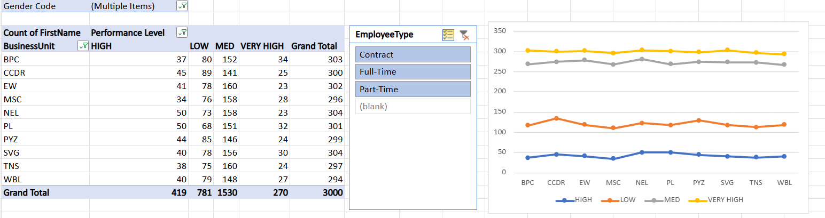

THE "WOW" IN OUR SOLUTION
PIVOT TABLE
SLICER
GRAPH
Performance level =IFS(J2>=5,"VERY HIGH",J2>=4,"HIGH",J2>=3,"MED",TRUE,"LOW")
3/21/2024 Annual Review
‹#›

Slide 10
MODELLING
STEP 1: SELECTING REQUIRED DATA
Download the Dataset:
- Obtain the employee data file from Kaggle and open it in Excel.
Select Relevant Columns:
- Identify and extract the following columns from the dataset:
- Employee ID
- First Name
- Last Name
- Exit Date
- Business Unit
- Employee Status
- Employee Type
- Employee Classification Type
- Gender Code
- Performance Score
- Current Employee Rating
- Performance Level
3. Highlight Columns:
- Highlight these columns in yellow for easy identification.
- In Excel:Select the column headers, right-click, choose "Format Cells," and apply a yellow fill color.
‹#›

Slide 11
Step 2: Eliminate Blank Exit Dates
Apply Conditional Formatting:
Highlight the Exit Date column.
Go to the "Home" tab and select "Conditional Formatting" > "New Rule."
Choose "Use a formula to determine which cells to format."
Enter the formula =ISBLANK(A1) (adjust cell reference as needed).
Set the formatting to highlight cells with a blank value (e.g., fill color).
Filter or Delete Blanks:
Use the filter option to view and remove rows with blank Exit Dates or clean up the data as needed.
Step 3: Define Performance Levels Using IFS Formula
Add a New Column for Performance Level Description:
Insert a new column next to the Performance Score.
Apply the IFS Formula:
In the new column, enter the formula to describe performance levels based on scores: excel.
Performance level =IFS(J2>=5,"VERY HIGH",J2>=4,"HIGH",J2>=3,"MED",TRUE,"LOW")
‹#›

Slide 12
Step 4: Create a Pivot Table
Insert a Pivot Table:
Select the entire dataset.
Go to the "Insert" tab and click on "PivotTable."
Choose where to place the PivotTable (new worksheet or existing worksheet).
Configure the Pivot Table:
Drag fields to the Rows and Columns areas to analyze data.
For example, place "Employee Type" in Rows, "Performance Level" in Columns, and "Performance Score" in Values.
Step 5: Add Slicers and Create Graphs
Insert Slicers:
Click on the PivotTable.
Go to the "PivotTable Analyze" tab and select "Insert Slicer."
Choose "Employee Type" (or other relevant fields).
Position the slicers on the worksheet for easy filtering.
Create a Pivot Chart:
With the PivotTable selected, go to the "Insert" tab and select "PivotChart."
Choose the desired chart type (e.g., bar chart, pie chart).
Format the chart to visually represent performance metrics and insights.

Slide 13
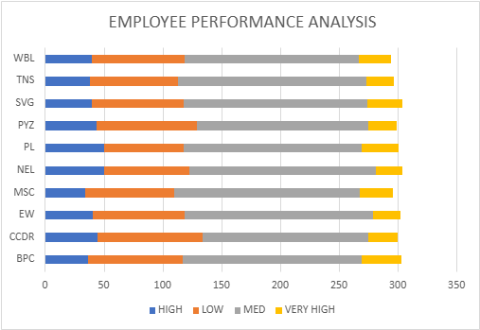
RESULTS
‹#›

Slide 14
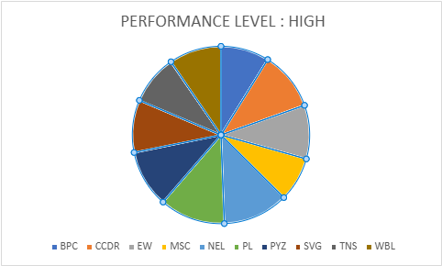
RESULTS
‹#›

Slide 15
Conclusion
The end output is created as employee performance analysis using various functions such as Pivot table , Graph etc. This helps to easily analyse the data. This performance analysis is used to find employees with greater efficiency.

